Slide 1
CSE302: COMPUTER NETWORKS PROJECT
INTERNET ACCESS AND ENRICH CONTROL ACROSS THE
RURAL AREA USING CPT
Submitted by
C.VEDA VARDHAN
Reg. No: 124160059
B. Tech. in Electronics & Communication Engineering (with Specialization in Cyber Physical Systems)
DECEMBER 2022
SCHOOL OF ELECTRICAL & ELECTRONICS ENGINEERING
THANJAVUR, TAMIL NADU, INDIA- 613 401
1

Slide 2
POINTS TO BE DISCUSSED
LITERATURE SURVEY
ABSTRACT
INTRODUCTION
CHALLENGES
NETWORK ARCHITECTURE
WORK DONE
1.IP CONFIGURATION OF NETWORK
2.SERVERS CONFIGURATION
3. PROXY SERVERS
RESULTS
CONCLUSION
FUTURE WORKS
REFERENCES

Slide 3
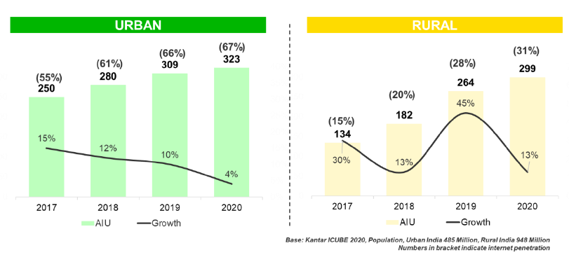
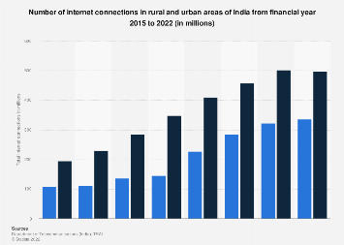

INTERNET USAGE: LITERACY SURVEY

Slide 4
ABSTRACT
In our day-to-day life, Computer Networks has become one of the essential aspects. It has become a core thing in our lives. Literally, every single sector that we come across daily is interlinked with a Computer Network and without this interconnection there is no word of proper communication
Therefore, this project is about INTERNET ACCESS AND ENRICH CONTROL ACROSS THE RURAL AREAS USING CPT . It is about designing a Network and configuring ISP and Providing Internet service in Rural Area. This Network topology is going to be achieved with the help of nodes such as Server, Routers, Switches, PCs, Wireless Devices and also this project deals with few other topics like Server Configuration (HTTP, DNS, IoT), IP Address Configuration, the transmission of Packets among the devices in the Network. All the routers in the Network are connected to the Global ISP.
This Project trends of Internet growth in Rural Areas and Internet access can be done through wireless and wired mode.
In Rural areas the population have poor or no internet connectivity and they are not known of usage of IoT devices in their daily life.By Providing Proper Internet Connectivity it leads to the development of rural communities.
My aim in this Project is to Provide good and High speed Internet Connectivity in rural areas in which rural area people can access high speed internet and they can utilize all services and also usage of IoT devices leads to energy conservation.

Slide 5
INTRODUCTION
Rural areas has very low bandwidth with disturbed Internet Connectivity which are reasons for the Poor rural Internet Penetration and also lack of computer systems and usage of smart IoT devices in rural areas. The internet provides immense potential for the development of rural communities. The network deployment should consider the possible use-cases like Egoverance and Education.
Poor infrastructure in rural areas leads to unstable electricity and very limited bandwidth with interrupted service. Insufficient rural Internet penetration is a result of poor Internet connectivity. Another block is lack of affordable computer systems and internet connections due to rural people’s lower income.
The need to use new information and new technology in rural areas should be generally accepted.
Rural people may also have different ideas and characteristics. Often there can be great artists but they don't get publicity because they live in small villages. Using the computer and the Internet, they can show their art around the world.

Slide 6
CHALLENGES
In rural areas and small towns, ISPs do not expect high costs for technologies developed and implemented in urban areas. In addition, low population density and high deployment costs hinder investment in ISPs Clusters.
As many Rural Areas do not of Access of Fast Internet.
Many people in rural areas are unaware of the use of IoT devices.
Rural people do not know how to properly use the internet services available in the world.
A slow internet connection or limited home connection in rural areas can cause students to fall behind academically.
Many rural areas do not have internet service and due to the lack of internet service people do not know what is happening in the world with in time and it takes span of time to know.
If rural areas have internet connection but no high speed connection due to lack of routers.
If rural areas have internet Connection but their data is not Secure.
Obsolete Technology: A prevalent issue with rural areas is that the infrastructure is not regularly updated with time and technology. For example, If 3G infrastructure was built in a remote village in India, even after the world is fast adopting 5G now, the village infrastructure remains obsolete and would only be 3G capable. Outdated technology and infrastructure would make the rural population helplessly stuck to use whatever network is available to them.

Slide 7
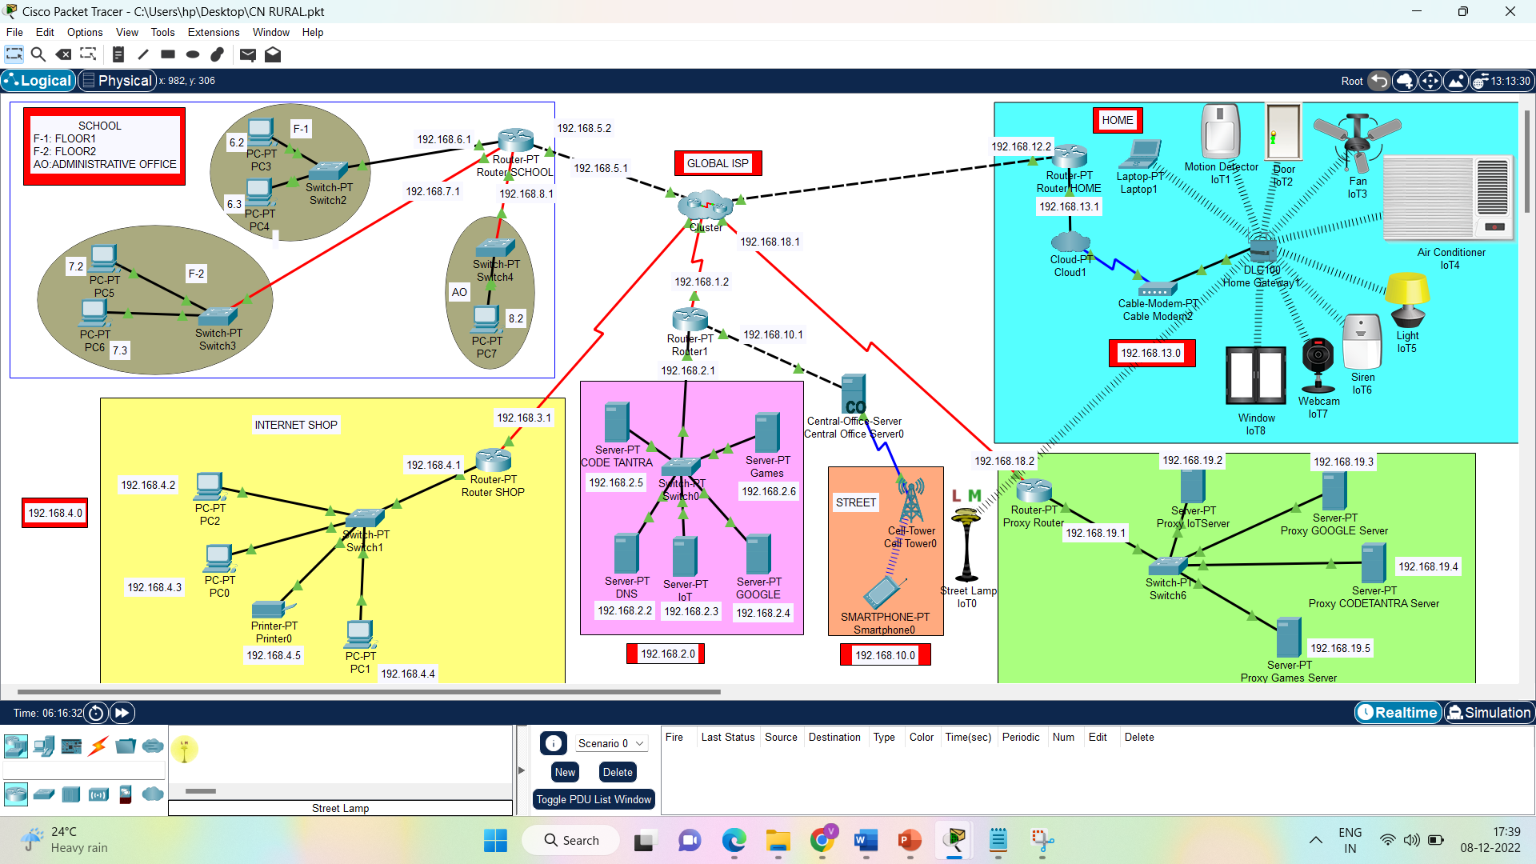
NETWORK ARCHITECTURE

Slide 8
DEVICES USED
S.NO | DEVICES | NO.OF.DEVICES USED
1 | SWITCH | 6
2 | ROUTERS | 7
3 | CENTRAL OFFICE SERVER | 1
4 | SERVER | 9
5 | CELL TOWER | 1
6 | SMART PHONE | 1
7 | PC | 8
8 | PRINTER | 1
9 | CLOUD PT | 1
10 | MODEM CLIENT | 1
11 | HOME GATEWAY | 1
12 | IoT DEVICES | 8

Slide 9
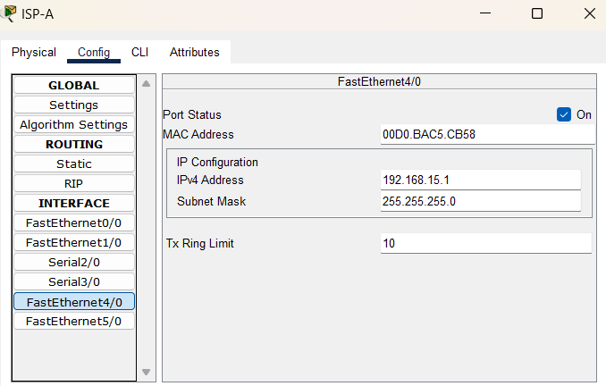
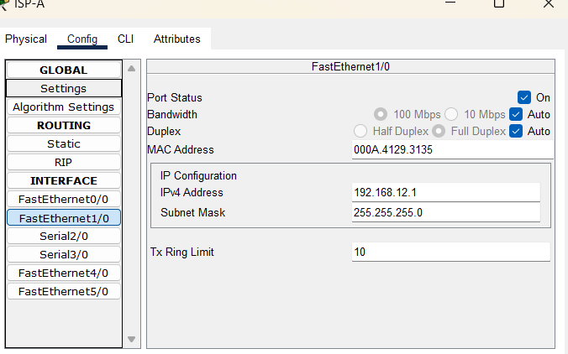
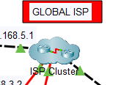
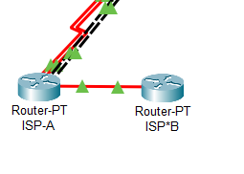
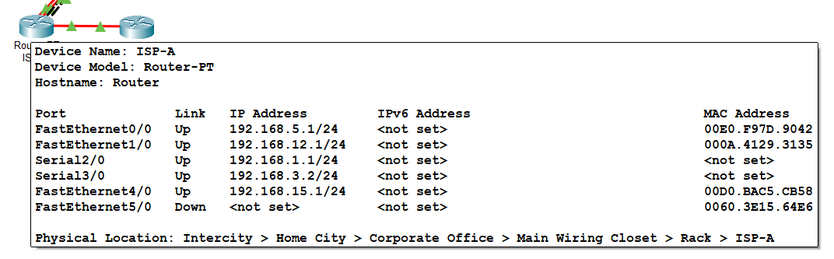
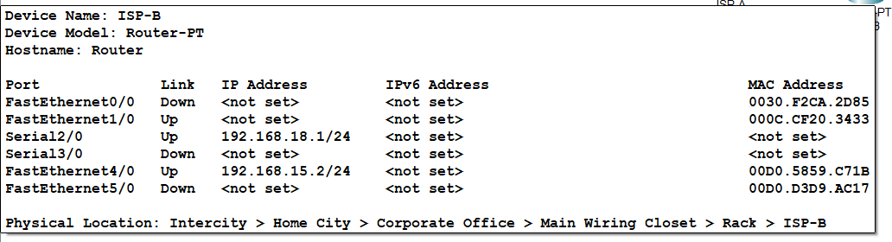
1.GLOBAL ISP CLUSTER-router and IP configuration
Global ISP Cluster.
Purpose of Cluster:-Two or more routers grouped together to provide any combination of hardware redundancy, service redundancy, load balancing and increased speed. The speed enhancement is accomplished by bonding the routers together.
We're utilising Class C IP addresses here.
An Ethernet cable carries the broadband signals between your modem, router, computer and other wired internet-capable devices. Cat 5e and Cat 6e (or higher) Ethernet cables are recommended for higher speeds.

Slide 10
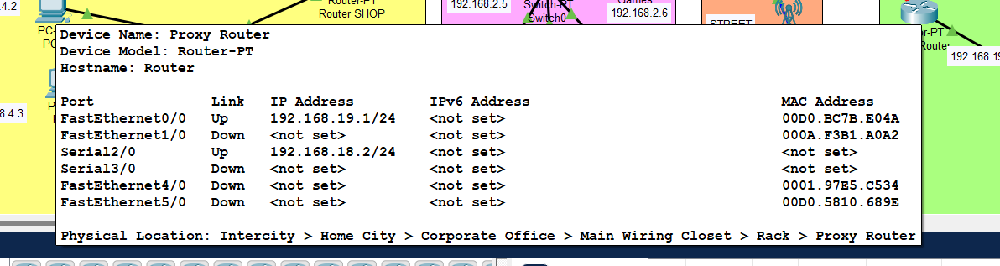
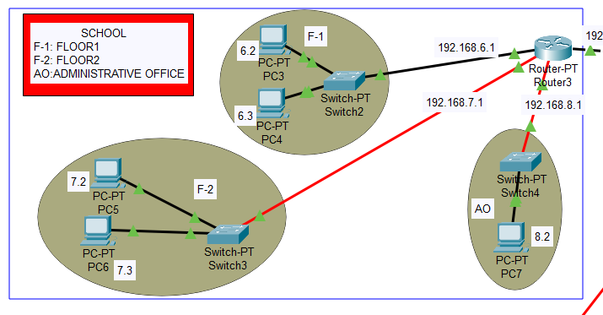
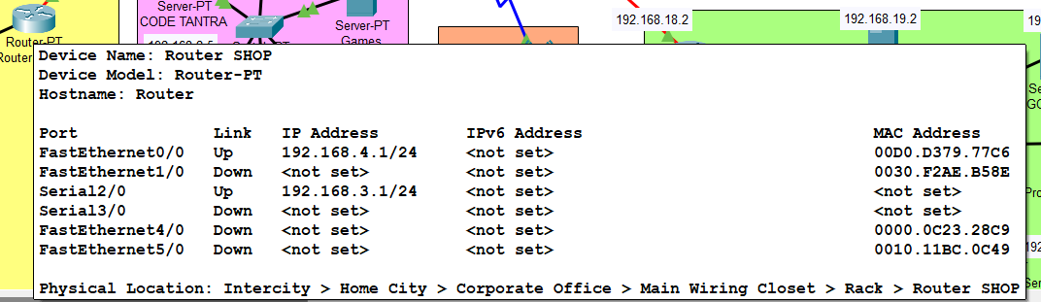
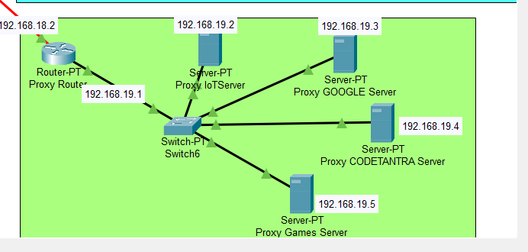
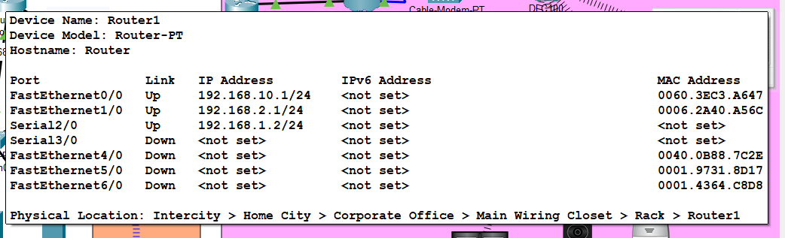
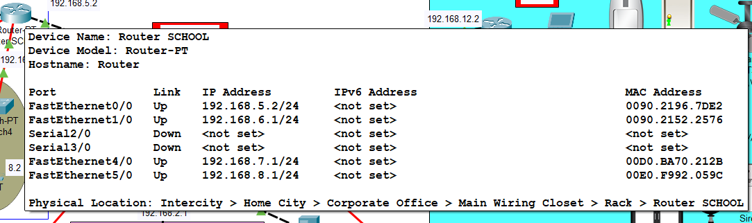
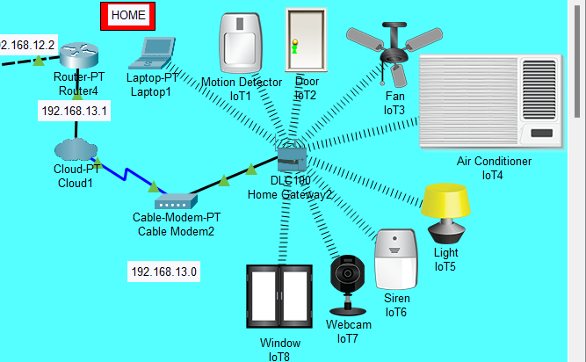
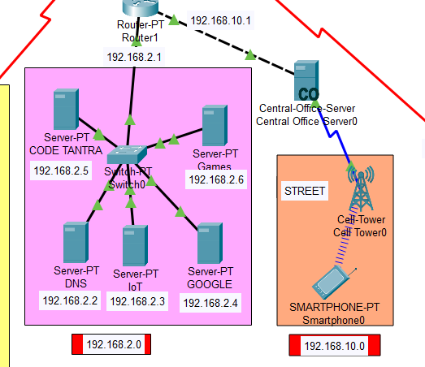
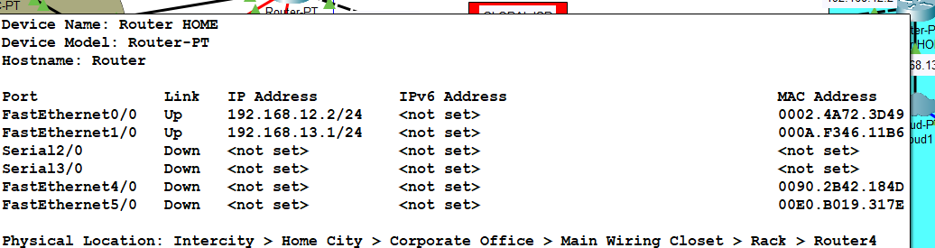
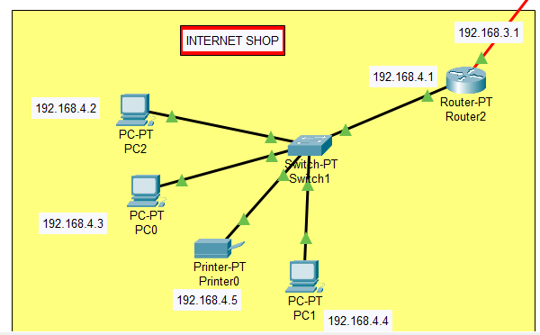
WORK DONE
In my Rural area Network Design it consists of School, Internet Shop, Home, Street.
School- One Router
Internet shop- One Router
Home- One Router
Admin Room- One Router
Proxy Server Room-One Router

Slide 11
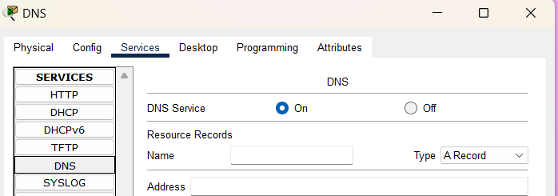
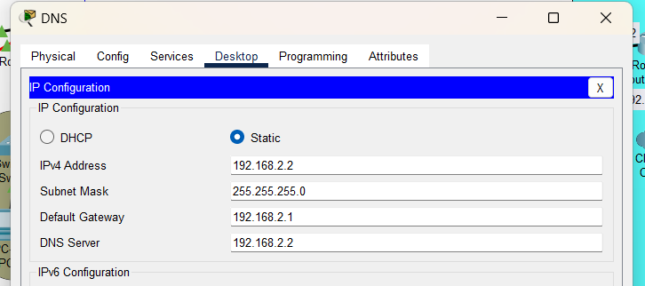
CONFIGURING AND ASSINGING IP’s for all Servers and PCS
S.NO | SERVER | IP ADDRESS | DEFAULT GATE WAY
1 | DNS | 192.168.2.2 | 192.168.2.1
2 | IoT | 192.168.2.3 | 192.168.2.1
3 | GOOGLE | 192.168.2.4 | 192.168.2.1
4 | CODETANTRA | 192.168.2.5 | 192.168.2.1
5 | GAMES | 192.168.2.6 | 192.168.19.1
6 | PROXY IoT | 192.168.19.2 | 192.168.19.1
7 | PROXY GOOGLE | 192.168.19.3 | 192.168.19.1
8 | PROXY CT | 192.168.19.4 | 192.168.19.1
9 | PROXY GAMES | 192.168.19.5 | 192.168.19.1
S.NO | DEVICE | IPv4 | DEFAULT GATE WAY | DNS SERVER
1 | PC 0 | 192.168.4.3 | 192.168.4.1 | 192.168.2.2
2 | PC 1 | 192.168.4.4 | 192.168.4.1 | 192.168.2.2
3 | PC 2 | 192.168.4.2 | 192.168.4.2 | 192.168.2.2
4 | PC 3 | 192.168.6.2 | 192.168.6.1 | 192.168.2.2
5 | PC 4 | 192.168.6.3 | 192.168.6.1 | 192.168.2.2
6 | PC 5 | 192.168.7.2 | 192.168.7.1 | 192.168.2.2
7 | PC 6 | 192.168.7.3 | 192.168.7.1 | 192.168.2.2
8 | PC 7 | 192.168.8.2 | 192.168.8.1 | 192.168.2.2
9 | PRINTER | 192.168.4.5 | 192.168.4.1 | 192.168.2.2

Slide 12
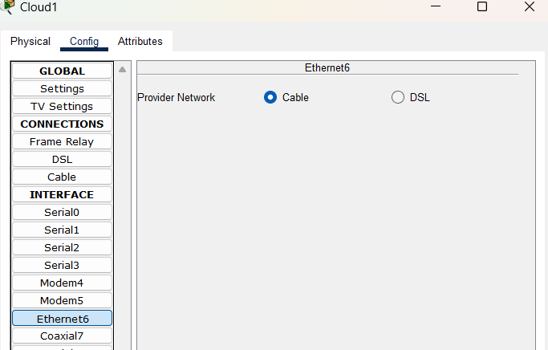
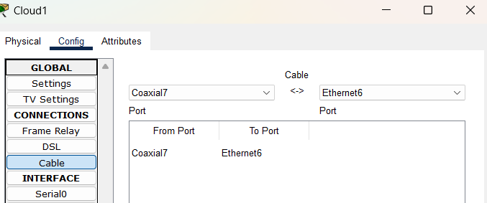
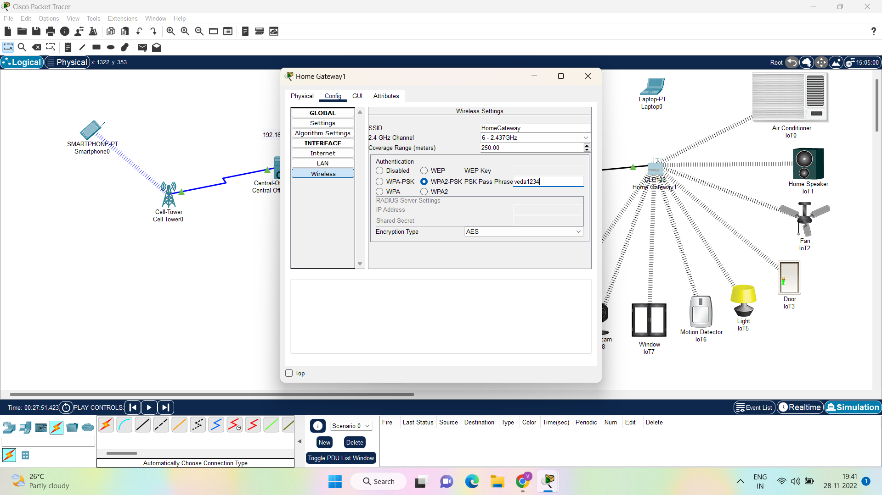
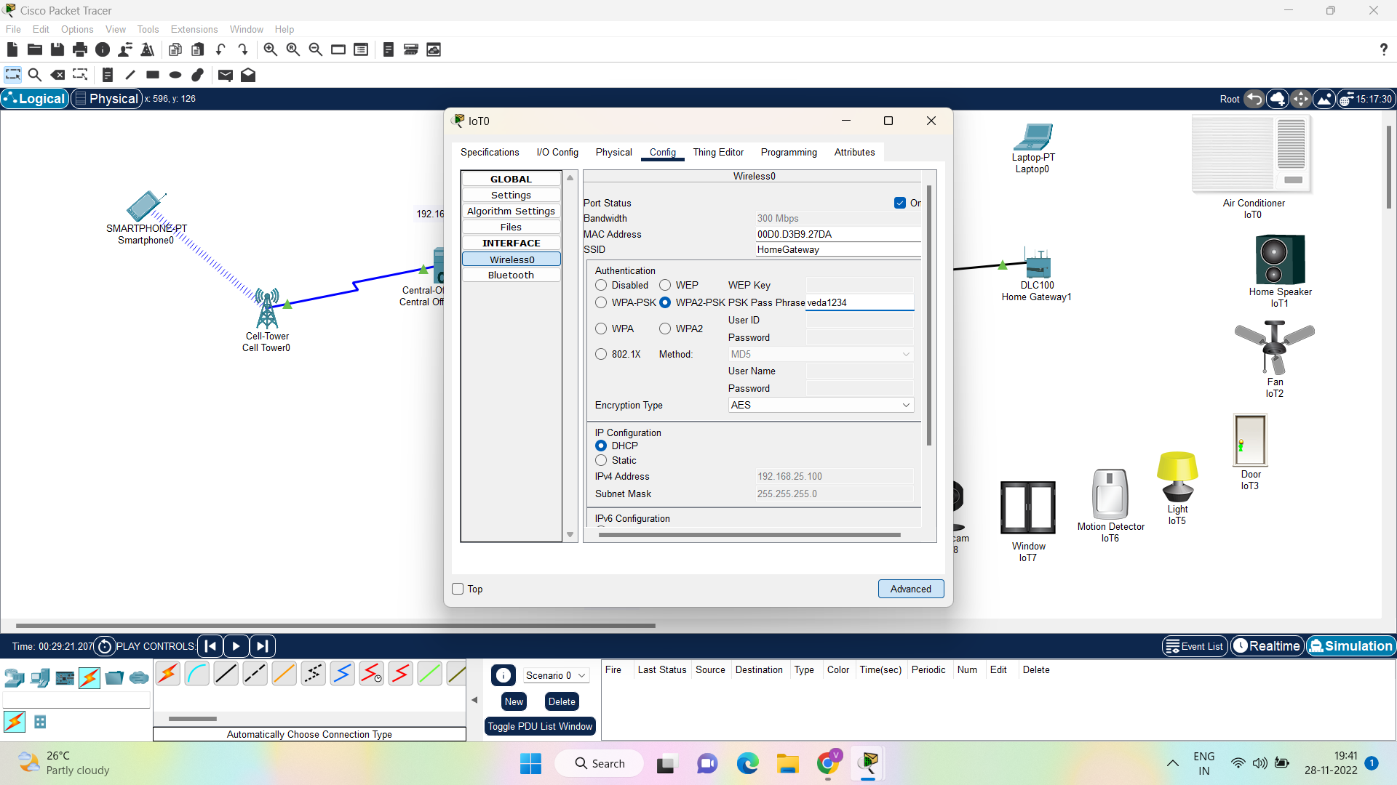
CONFIGURING HOME

Slide 13
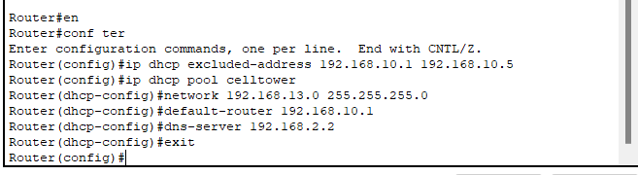
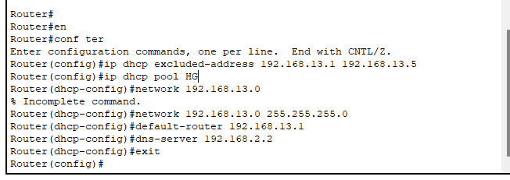
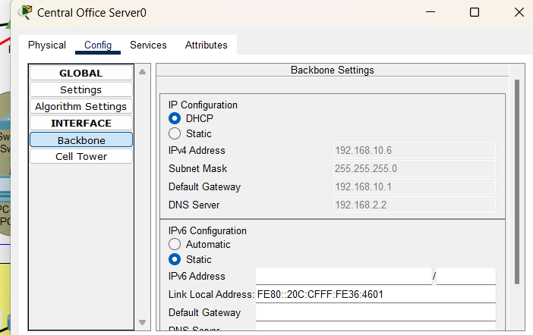
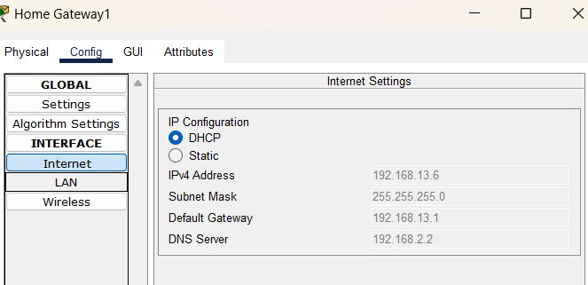
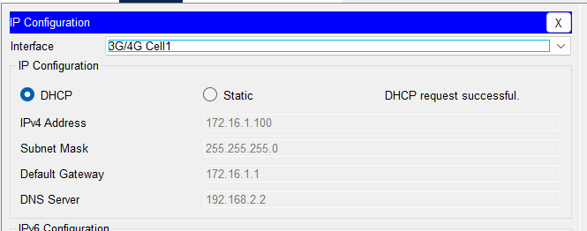
DHCP
DHCP: Dynamic Host Configuration Protocol(DHCP) is an application layer protocol which is used to provide Subnet Mask , Router Address , DNS Address. DHCP is a client/server protocol that automatically provides an Internet Protocol (IP) host with its IP address and other related configuration information such as the subnet mask and default gateway.

Slide 14
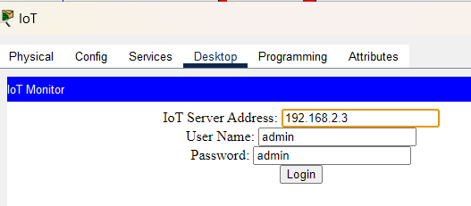
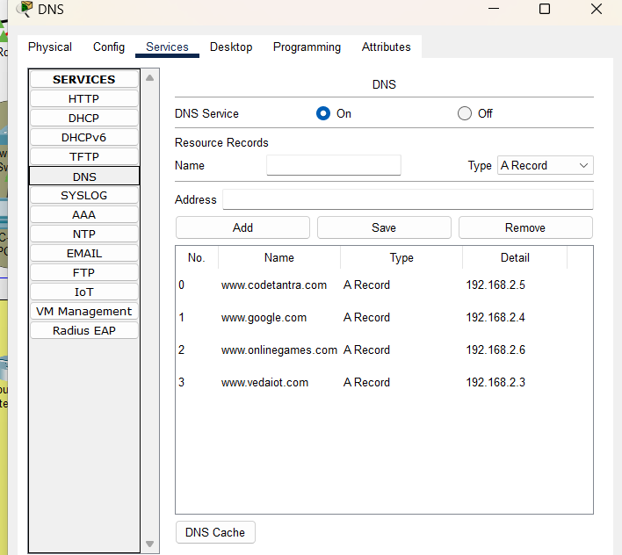
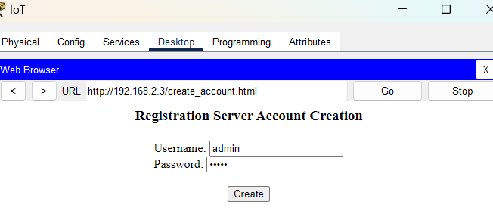
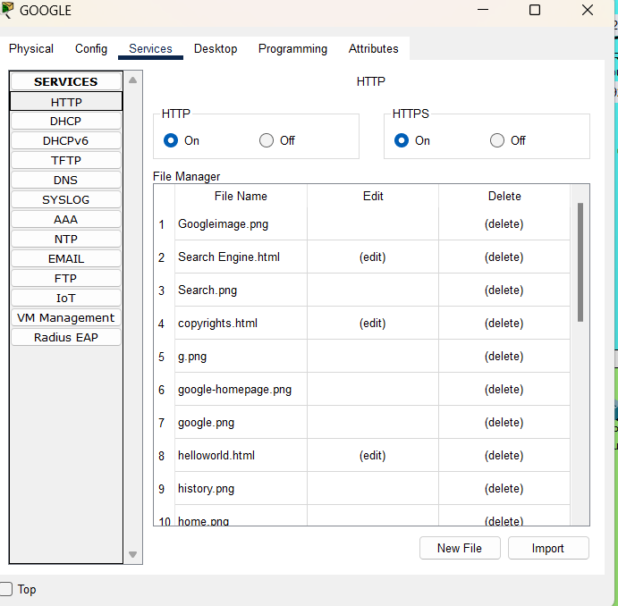
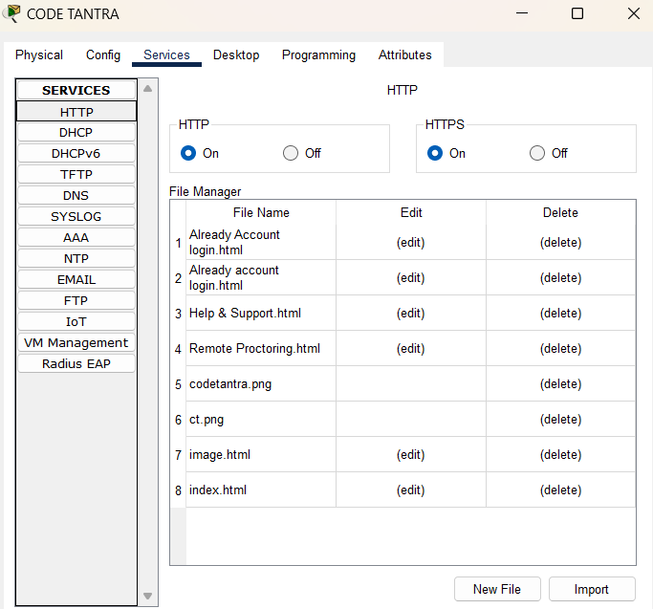
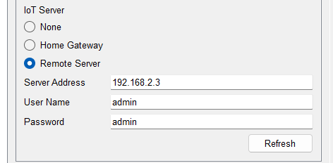
SERVERS CONFIGURATION

Slide 15
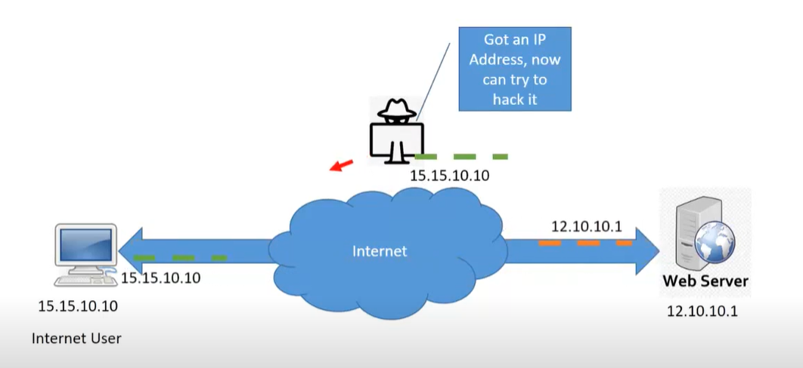
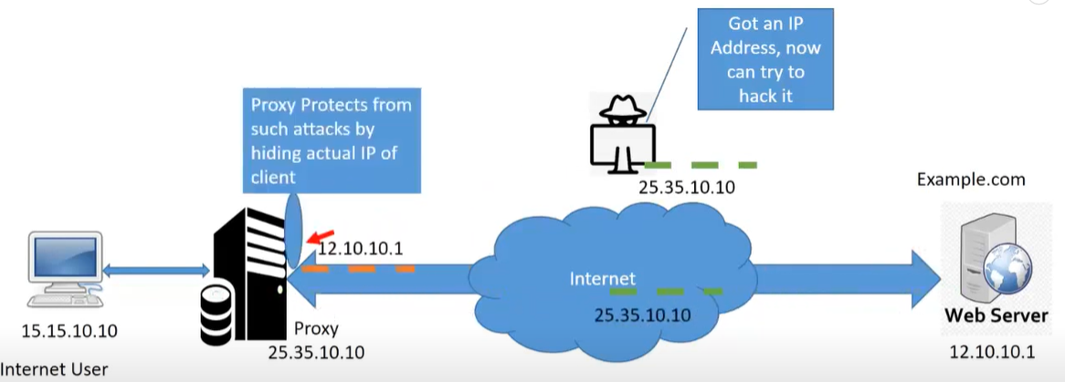
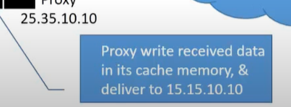
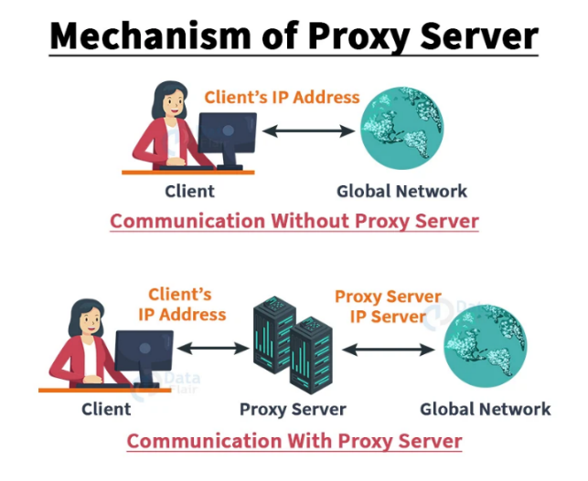
3.PROXY SERVERS
BENEFITS OF PROXY SERVER
Security: Hides User Identity from Hackers and Other Agencies.
Speed: Increases speed Using Cache Memory.
Save Bandwidth : Using Cache, helps to reduce Internet Bandwidth requirement.
Authentication: Proxy Server enable user authentication.
Site Filtering : Using Proxy, Particular Websites can be allowed or restricted.

Slide 16
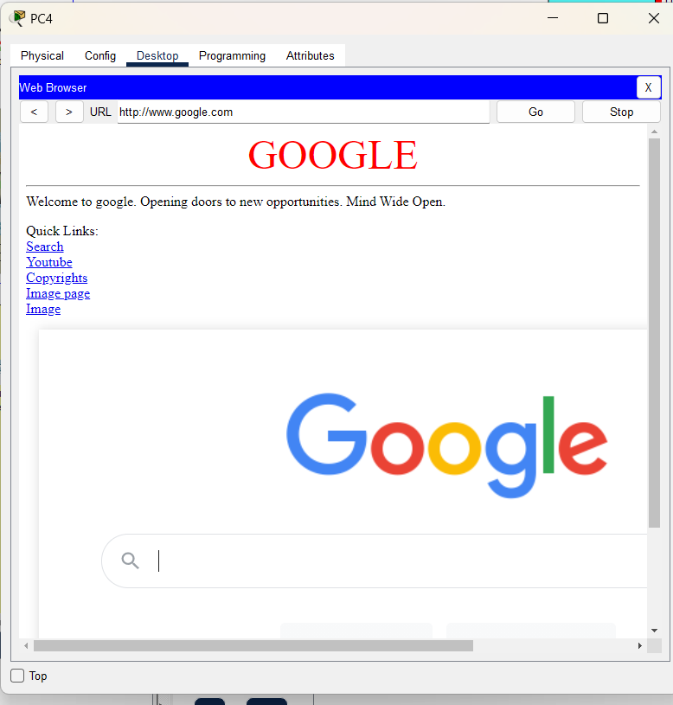
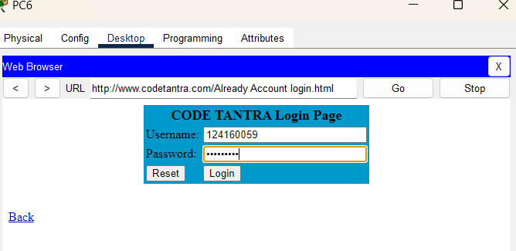
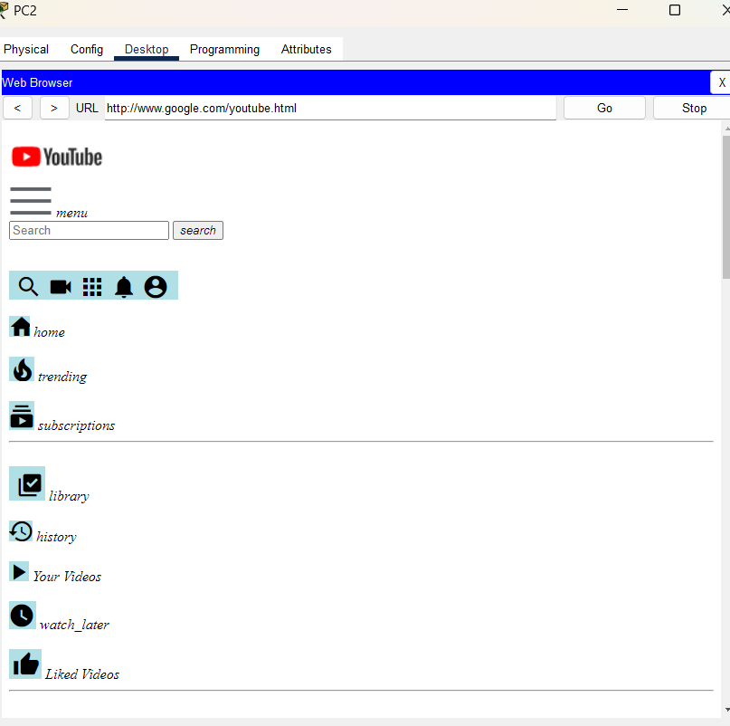
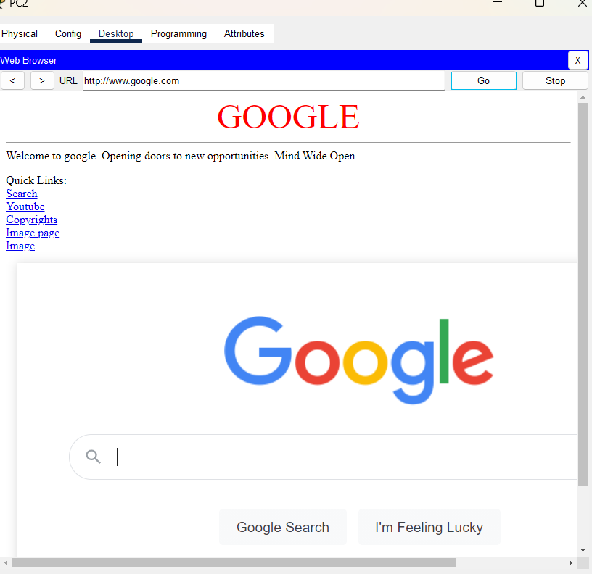
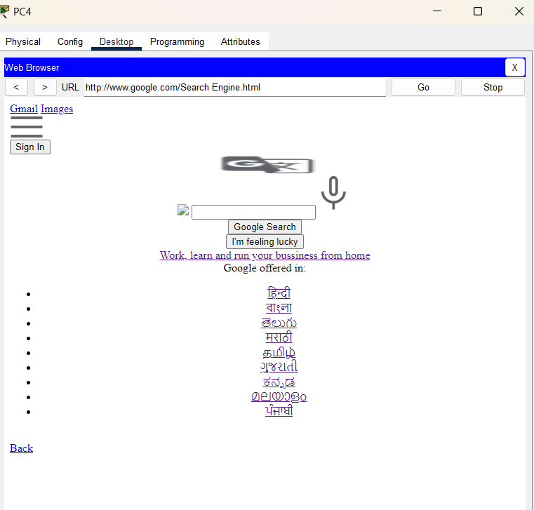
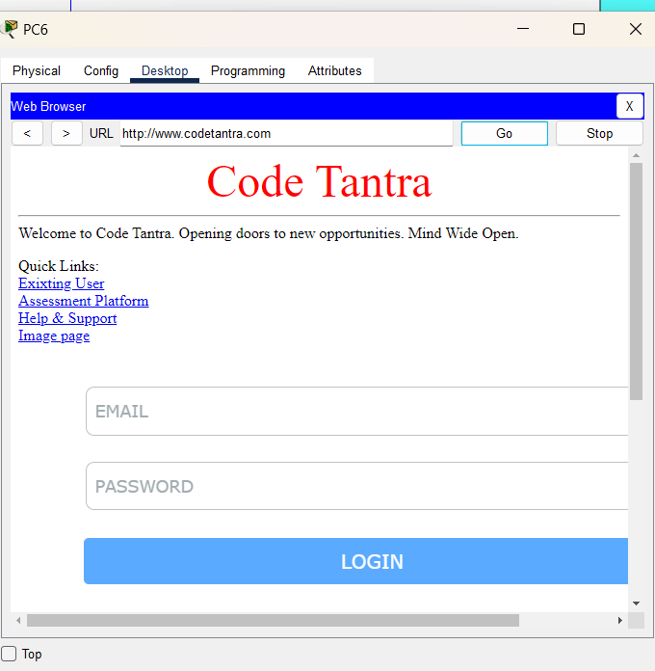
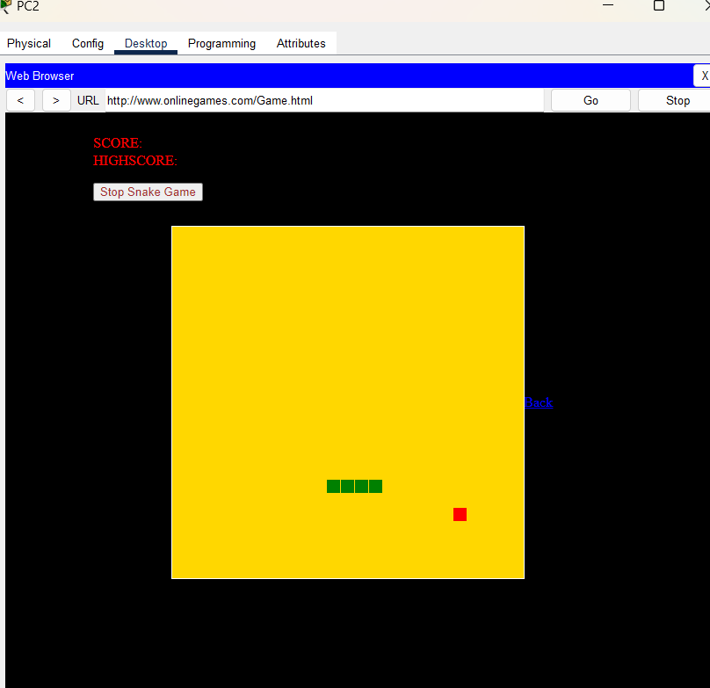
RESULTS
SCHOOL
INTERNET SHOP

Slide 17
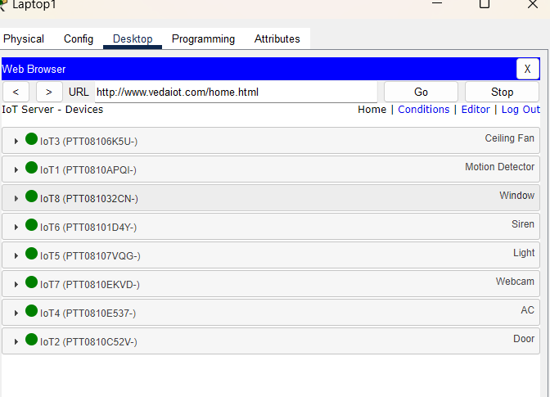
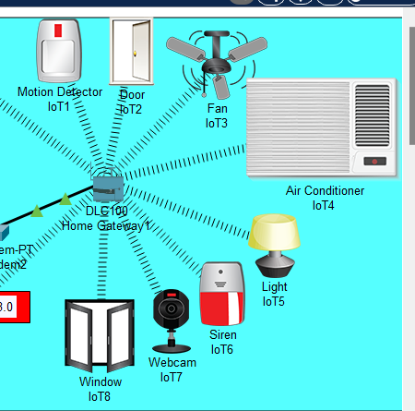
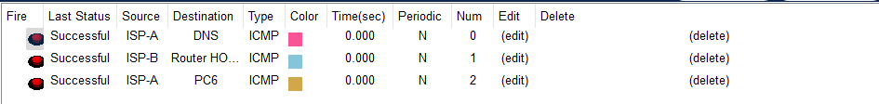




HOME
SIMULATION

Slide 18




NETWORK PARAMETERS
Packet Loss: Packet loss is the failure of data packets to be successfully transmitted over the network from sender to receiver.
This is calculated using ping command, by sending 4 packets from sender to receiver.
Percentage of packet loss = ((Packet data send-Packet data receive)/Packet data send) x100
End-to-end delay=RTT/2
SENDER – PC4 RECIEVER-CODE TANTRA SERVER
Percentage of packet loss= ((Packet data send-Packet data receive)/Packet data send)x100
Percentage of packet loss= ((4-3)/4)x100=25%
ROUTING TABLES

Slide 19
CONCLUSION
This report describes the network design and providing Internet Service in Rural Area. The network is equipped with Wireless Area Networks, Server Rooms, operational efficiencies, PCs designated for web access and feedback provision. All the IoT devices are Secured with Password.
Rural areas are a great opportunity to offer new technology. Rural areas play an important role in the growth of the country's economy. Bringing internet access and technology to rural areas has the potential to be a huge success for the country's economy.
This reports trends in the growth of the Internet in rural areas, mainly focusing on the impact of the Internet on rural areas.
The survey analysis was conducted to determine the impact of certain parameters influencing Internet growth in rural. The analysis also found correlations with urban Internet access in wireless and wired modes.
The growth rate of the Internet is closely related to the subscription rates of wired broadband and wireless modes.
By using IoT devices in rural areas, people can save energy consumption and it leads to Energy Conservation.
Finally, the whole network is well equipped with services to enable good internet service among the various sectors in the rural area.

Slide 20




FUTURE WORKS
It is very expensive and logistically challenging to install Fiber, one of the main infrastructures for high-speed internet connectivity, especially in Rural Areas.
In Future we can able to provide Fast Internet Access from Satellites.
People in rural areas have less broadband Internet access due to a combination of economic disadvantages, technical difficulties and lack of service providers. There is a great need to develop robust, low-cost and easy-to maintain network management platform for Wireless Internet Service Providers (WISP) in rural areas.
Fixing Wireless Broadcasting Internet Services.
A WiMax Internet is a broadband connection providing high-speed bandwidth delivered wirelessly from the service provider to a location. Worldwide Interoperability for Microwave Access is a family of wireless broadband communication standards based on the IEEE 802.16 set of standards.

Slide 21
REFERENCES
15
1. Rural internet connectivity: Author links open overlay panelSharonStrover https://www.sciencedirect.com/science/article/pii/S0308596101000088
2.Transition to the Digital Terrestrial Television: an opportunity to create broadband infrastructures and extend the broadband core backbones in dispersed locations, small cities and rural areas E. Pallis, C. Mantakas, G. Mastorakis, A. Kourtis, V. Zacharopoulos https://grc.webs.upv.es/members/calafate/download/CR_paper_wisp.pdf
3. Enabling Rural Connectivity with SDN https://www.academia.edu/download/31043589/Enabling_Rural_connectivity_with_SDN.EECS-2012-201.pdf
4. Development of an Open Source Network Management & Monitoring Platform for Wireless Broadband Service Provider in Rural Areas https://ieeexplore.ieee.org/abstract/document/5612169/
5. Low-cost sustainable wireless Internet service for rural areas Abdul Hameed, Adnan Noor Mian & Junaid Qadir https://link.springer.com/article/10.1007/s11276-016-1415-8
6. Analyzing the Impact of Internet in Rural India M. Prabu, R.Manoov https://www.researchgate.net/profile/Prabu_Madhavan/publication/264159967_Analyzing_the_Impact_of_Internet_in_Rural_India/links/5c134b864585157ac1c07b76/Analyzing-the-Impact-of-Internet-in-Rural-India.pdf

Slide 22

17

